Slide 1
HOSPITAL DATABASE MANAGEMENT SYSTEM
GROUP 18
MEMBERS
NAAZNI YAHYA B200696CS
LAKSHMI S B200700CS
FALGUNI BISWAS B200784CS
PRITHVI CHANCHAL B200854CS
DIVYANG JAIN B200826CS

Slide 2
Objective
1.To deal with the Hospital Management System in an easy and efficient manner.
2.Create a strong database that allows for any connection in a discreet way, to prevent any outside or inside attacks.
Scope of the Project
Information about Patients is stored by just writing the Patients' names, ages and gender. Whenever a new Patient comes up their information is stored.
Information of all doctors in different departments and functionality to book appointments online.
Medical history of all patients that include prescription and diagnosis and associated bills will also be stored in a patient’s account.
There will be an accounts department managing the finance.
Overall Description
System Requirement The Web Application has three main parts:
1) Hospital Administrators
2) Doctors
3)Users/Patients
The patients can book appointments with doctors in their preferred departments. The system will fix them with an appointment at a time convenient to both the patient and the doctor. The doctors can log in and mention their available slots. The admins will maintain the database and will manage bill payments.
User Requirements Definition
The user requirement for this system is to make the system fast, flexible, less prone to error, reduce expenses and save time.
1. Less human error
2. Strength and strain of manual labor can be reduced
3. High Security
4. Data redundancy can be avoided to some extent
.

Slide 3
5. Data consistency
6. Easy to handle
7. Easy data updating
8. Easy record keeping
9. Backup data can be easily generated
System Requirement Specification
Functional System Requirement
This section gives a functional requirement that applies to the HMS.
These are sub-modules in this phase.
● User Module
● Doctor Module
● Admin Module:
1. Delete or add Patients
2. Delete or add Doctors
3. Manage bills and transactions
● User Module:
1. View appointment list and status with doctors
2. View prescription details
3. View doctor list
4. Manage own profile
5. View Diagnosis history

Slide 4
● Doctor Module
1. Manage patients. account opening and updating
2. Create, and manage appointments with the patient
3. Create a prescription for the patient
4. Provide medication for patients
5. Manage own profile
Non-Functional System Requirements:
1. Performance Requirements :
Some Performance requirements identified are listed below:
1. The database shall be able to accommodate around thousand records to store.
2. The software shall support the use of multiple users at a time.
2. Safety Requirements :
The database may get crashed at any certain time due to viruses or operating system failure. Therefore, it is required to take the database Backup.
3. Security Requirements
Some of the factors that are identified to protect the software from accidental or malicious access, use, modification, destruction, or disclosure are described below. Keep a specific log or history of data sets
1. Assign certain functions to different modules
2.Restrict communications between some areas of the program
3. Check data integrity for critical variables
4. Later version of the software will incorporate encryption
5. techniques in the user/license authentication process.

Slide 5
Hardware Requirements
● Processor: Pentium or greater
● RAM: 512MB
● Hard Disk: Depends on how much data is stored in DATABASE (min 1GB)
● Keyboard
● Monitor
Software Requirements
● OS: Linux
● Database: SQL
Assumptions
Offline patients will be taken care separately and there is different system to manage data of the offline patient.
Offline patient's database will be managed by the staff of the Hospital itself.
If a patient comes directly to doctor in offline mode i.e. without prior appointment then it is up to the doctor to accept them and it won’t affect the online appointment.
Patients will apply for an appointment and doctor will get the request, after that he will decide whether to accept it or not.
Doctor will finalize the appointments only if he has free slots. Appointments will be finalize by doctor itself. There is no role of third party into that.
As the appointment is confirmed, it is assumed that the patient has paid the money and it will be recorded in the database.
Adding/deleting/updating entries in the database will be done by Admin only.
Admin is handling entries of departments, doctors and patients.
Every Doctor has fix consultation charge which is 200RS per appointment.
Admin handles if a patient has paid for the appointment or not.
An admin is there in the hospital which is managing the Hard Copy of the database
Doctor can choose schedule number which is already predefined by admin, in which they will diagnose patients.

Slide 6
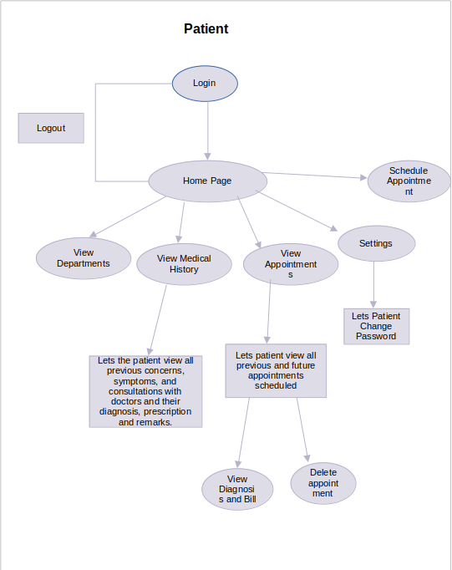
CONTROL FLOW

Slide 7
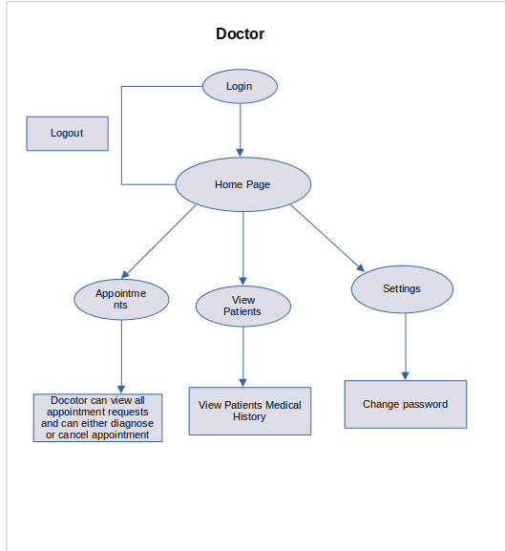

Slide 8
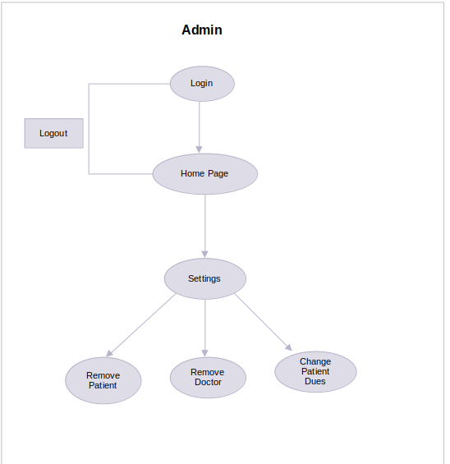

Slide 9
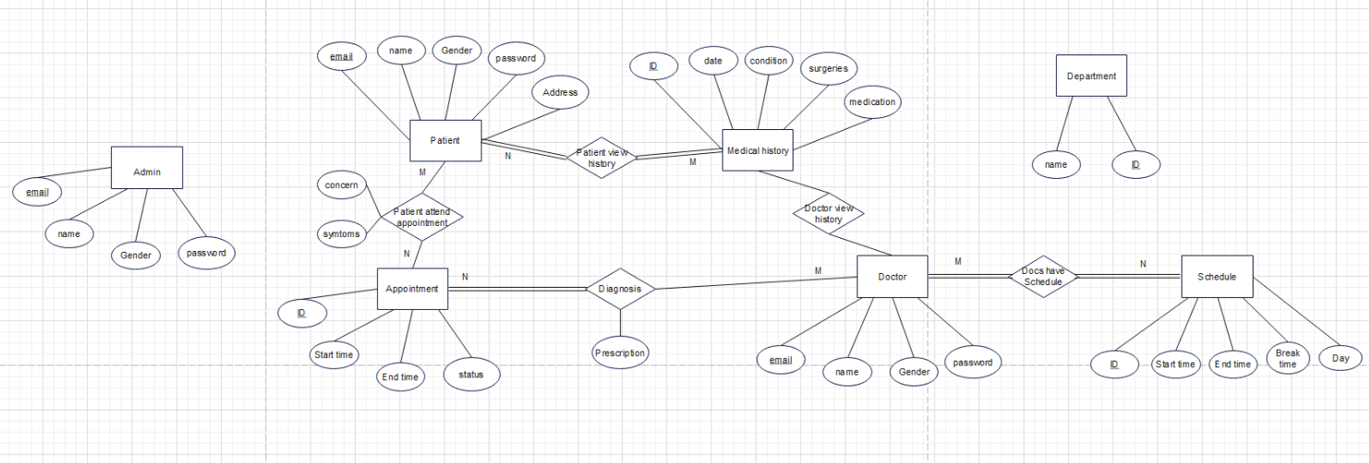
ER Diagram

Slide 10
RELATIONAL SCHEMA
MEDICAL HISTORY
PATIENT
Attribute | Data Type | Description
id | int | Id of Record PRIMARY KEY
date | date | Date of Record
conditions | varchar | Medical conditions
surgeries | varchar | Surgeries undergone
medication | varchar | Medication prescribed
Attributes | Data Type | Description
email | varchar | Email id of patient PRIMARY KEY
name | varchar | Patient name
gender | varchar | Patient gender
password | varchar | Password
address | varchar | Patient address
APPOINTMENT
DOCTOR
Attributes | Data Type | Description
id | int | Appointment ID PRIMARY KEY
date | date | Date of Appointment PRIMARY KEY
starttime | time | Starting time PRIMARY KEY
endtime | time | Ending time PRIMARY KEY
status | varchar | Status of Appointment PRIMARY KEY
Attributes | Data Type | Description
email | varchar | Email id of Doctor PRIMARY KEY
name | varchar | Doctor name
gender | varchar | Doctor gender
password | varchar | Password

Slide 11
ADMINS
DEPARTMENTS
Attributes | Data Type | Description
email | varchar | Email id of Admin PRIMARY KEY
gender | varchar | Gender
password | varchar | Password for account
name | varchar | Name of Admin
Attributes | Data Type | Description
id | int | Department ID PRIMARY KEY
name | varchar | Department Name
PATIENTATTENDAPPOINTMENTS
SCHEDULE
Attributes | Data Type | Description
patient | varchar | PRIMARY KEY FOREIGN KEY referencing patient email
appt | int | PRIMARY KEY FORIEGN KEY referencing appointment id
concerns | varchar | Patient concerns
symptoms | varchar | Patient symptoms
Attributes | Data Type | Description
id | int | PRIMARY KEY Schedule ID
date | date | PRIMARY KEY Scheduled Date
starttime | time | PRIMARY KEY Starting time
endtime | time | PRIMARY KEY Ending time
status | varchar | PRIMARY KEY Schedule Status

Slide 12
DIAGNOSE
DOCSHAVESCHEDULES
Attributes | Data Type | Description
appt | int | PRIMARY KEY FOREIGN KEY referencing appointment id
doctor | varchar | PRIMARY KEY FOREIGN KEY referencing doctor email
diagnosis | varchar | Diagnosis
prescription | varchar | Prescription
dues | int | Dues left to pay
Attributes | Data Type | Description
sched | int | PRIMARY KEY FOREIGN KEY referencing schedule id
doctor | varchar | PRIMARY KEY FOREIGN KEY referencing doctor email
DOCTORVIEWSHISTORY
PATIENTSFILLHISTORY
Attributes | Data Type | Description
history | int | PRIMARY KEY FOREIGN KEY referencing medical history id
doctor | varchar | PRIMARY KEY FOREIGN KEY referencing doctor email
Attributes | Data Type | Description
patient | varchar | FOREIGN KEY referencing patient email
history | int | PRIMARY KEY FOREIGN KEY referencing patient email

Slide 13
Introduction to the website
Log In page
1. Create Account
2. Sign In
Home Page
Patient
1. View Department
2. Make Appointments
3. View Appointments
4. Change Password
5. View Medical History
6. Sign Out
Doctor
1. Appointments
2. View Patients
3. Settings
4. Sign Out
Admin
1. Settings
2. Sign Out

Slide 14
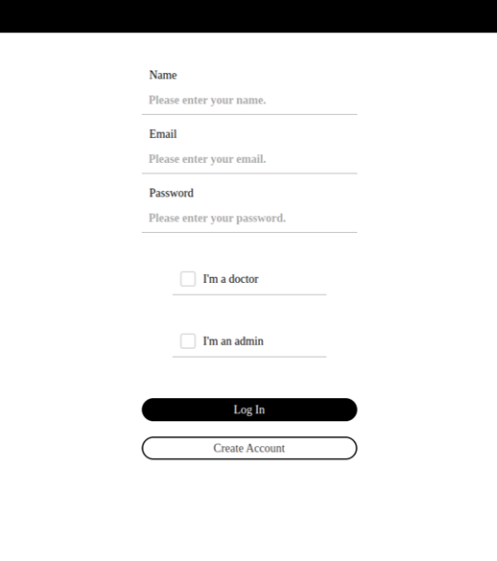
Log In Page
Enter Your Credentials: -
Name
Email
Password
There is no need to select any check boxes if you are a patient.
For doctors, select I am a doctor
For Admins, select, I am an admin check box.
If you don’t have an existing account, then create one by selecting CREATE ACCOUNT.

Slide 15
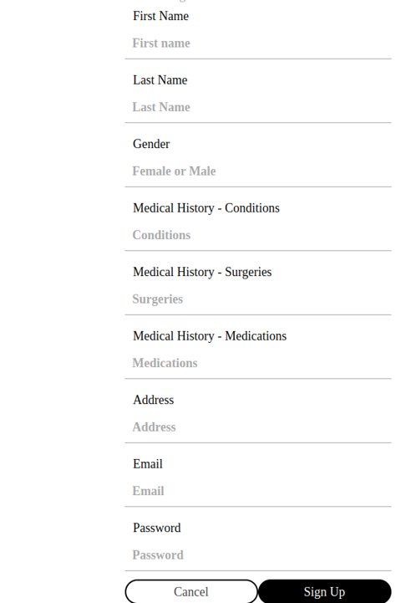
Create Account Page
Enter the required details in the option, which includes: first name, last name,
gender, medical history (conditions, suggestions, and medications), address,
email, and password.
After giving your details, click on the "Sign Up" button. Your account will be
created in the database, and now you can use these details to
log in to your account as shown on the previous page.

Slide 16
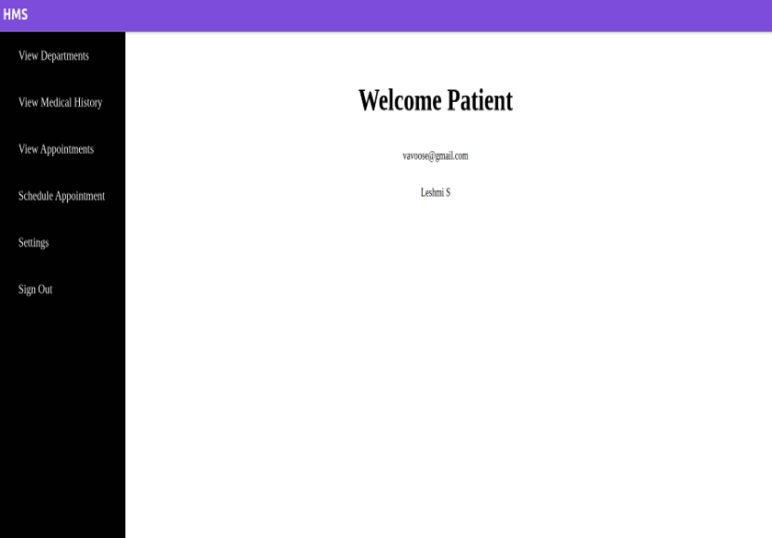
Home Page and Dialogue Box
Signing In as a Patient

Slide 17
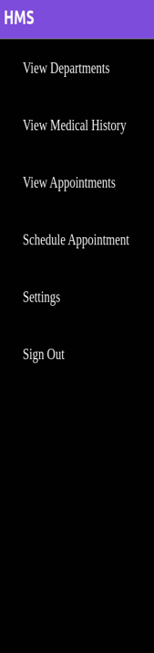
On the left side of the Welcome Patient Page, there will be a menu box, which will contain the respective button.
Selecting each button will take you to a different page, which will contain the respective details as mentioned in the name.
View Departments: This displays the names of the departments in the hospital.
View Medical History: This displays the Medical History of the Patient.
View Appointments: This displays the Appointment of the patient.
Schedule Appointments: This display the webpage where you can request for an appointment
Settings: This displays the webpage where you can change the password for your account.
Sign Out: This will lead you to signing out from the Patient Portal.

Slide 18
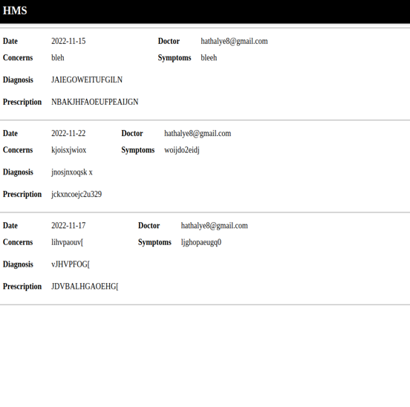
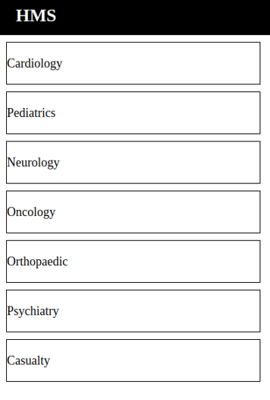
View Departments View Medical History

Slide 19
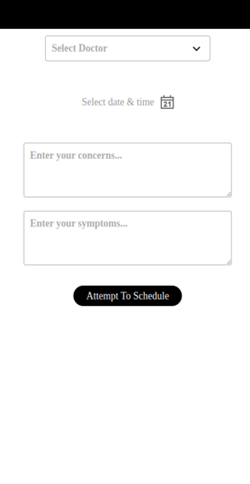
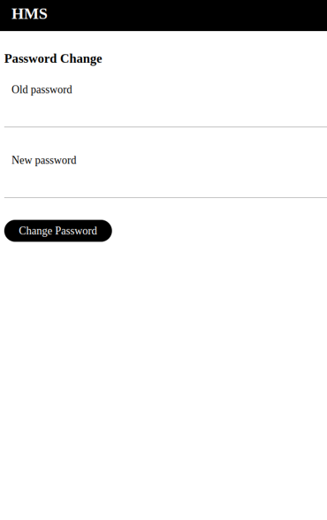
Schedule Appointment Settings

Slide 20
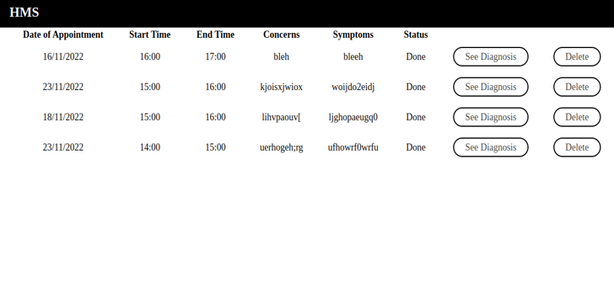
View Appointments
The appointment is already scheduled, and on this webpage, the patient can check the diagnosis and delete the appointment as well.

Slide 21
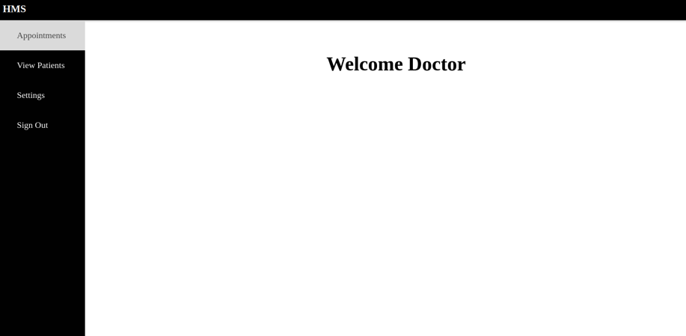
Signing In as a Doctor

Slide 22
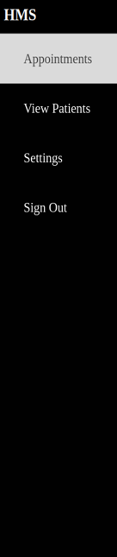
This menu box will be appeared on the left side of the Doctor Page.
There are four options:-
-Appointments: - On the patient page, we saw that the patient would make the appointments. Now those requests will
come to the doctor, and he will either accept them or reject them. If he accepts, the appointment
will be scheduled.
-View Patients: - Doctor can check the patients and prescribe prescriptions on the webpage which will appear.
-Settings: - This will display the webpage, where doctor can change the password. It is same as patient Settings Page.
-Sign Out: - Signing Out from the portal

Slide 23
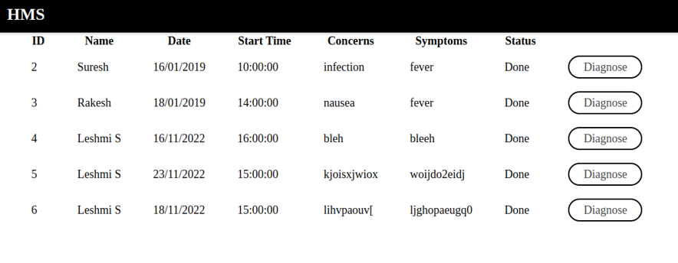
Appointments
The appointments requested for a particular doctor will be visible on this page, and he can either accept them or reject them. He will be able to see the patient's report on the next page after clicking on Diagnose, which will be reflected in the patient's medical history and diagnosis portal.

Slide 24
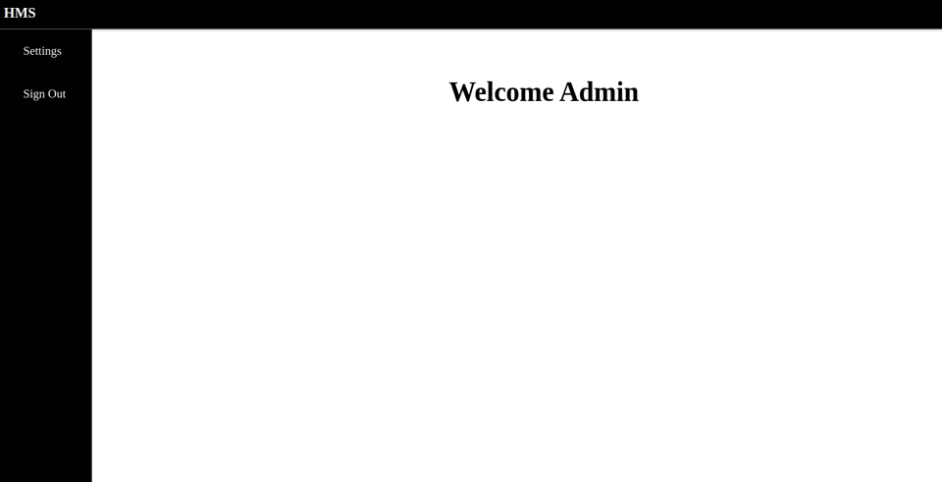
Signing In as an Admin.

Slide 25
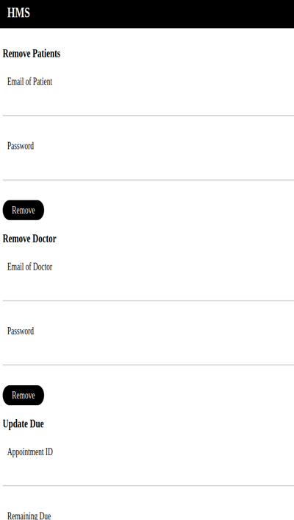
Admin has access to the database and is responsible for removing doctors and patients from it.
Once an entry is deleted, all the information regarding that particular person will be removed, and he will no longer
be part of the system, which means he cannot sign in.
Along with this the admin is also responsible for updating the dues for a patient which shall be reflected
in patient portal.

Slide 26
Future Implementations
1. Provide an online pharmacy service:
2. Provide online payment service
3. Ward allocations
4. Laboratory Test Booking
5. Blood Bank services
6. Add more departments
7. Maintain Vaccinations Records
8. Option to Sign Up as a Volunteer

Slide 27
Thank You

